Slide 1
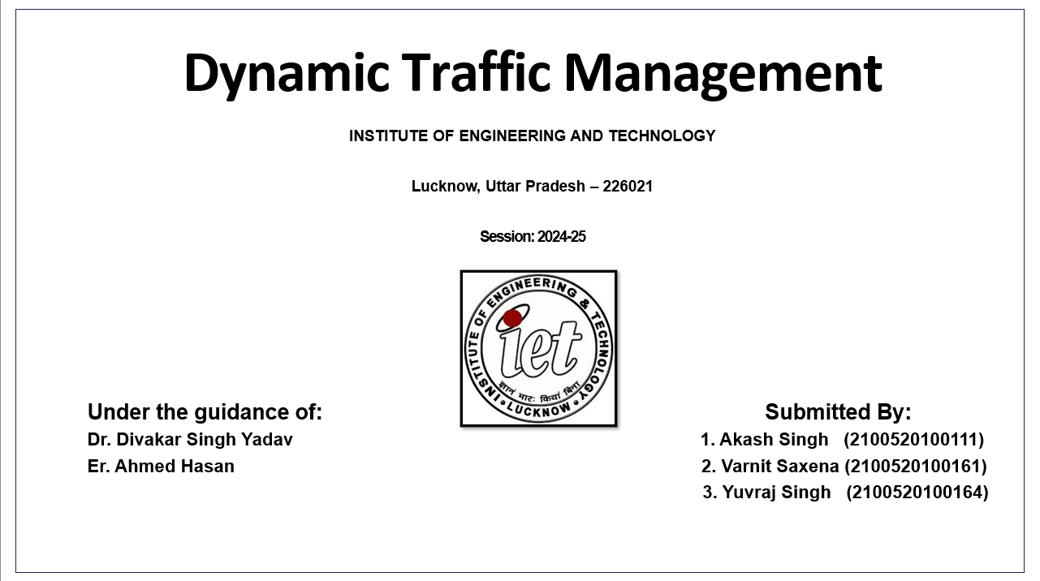

Dynamic Traffic Management
INSTITUTE OF ENGINEERING AND TECHNOLOGY
Lucknow, Uttar Pradesh – 226021
Session: 2024-25
Under the guidance of: Submitted By:
Dr. Divakar Singh Yadav 1. Akash Singh (2100520100111)
Er. Ahmed Hasan 2. Varnit Saxena (2100520100161)
3. Yuvraj Singh (2100520100164)
Notes:
1

Slide 2
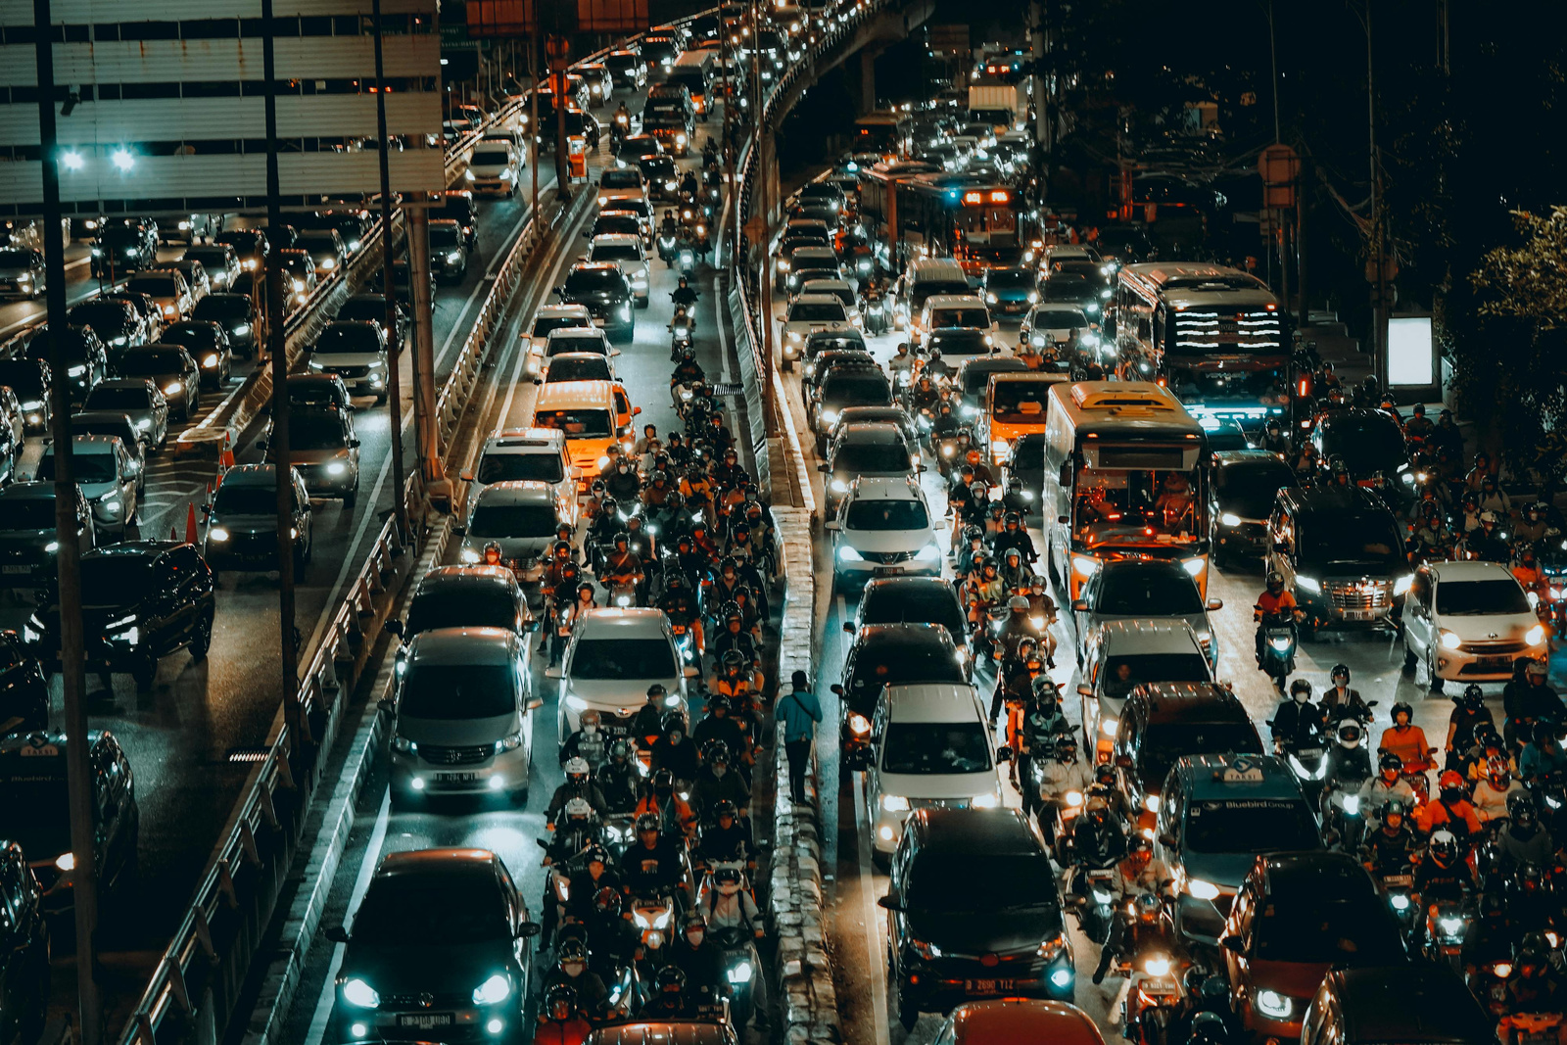
Background
Traffic congestion significantly impacts urban mobility, leading to delays, increased emissions, and economic losses.
Static or manual systems fail to adapt dynamically to real-time traffic conditions
Machine learning provides a dynamic approach to traffic management.
The project uses YOLO for real-time vehicle detection and signal optimization.
Notes:
2

Slide 3


Problem Statement
Static signal timings fail to adapt to real-time traffic fluctuations.
Manual traffic management is error-prone and labor-intensive.
Existing sensor-based systems are expensive and difficult to maintain.
Inefficiencies lead to long wait times and fuel wastage.
Lack of fairness in signal allocation, with low-density lanes often neglected.
Notes:
3

Slide 4

Proposed Solution
Integrates YOLOv8 for real-time vehicle detection from live or recorded video feeds with classification into cars, buses, trucks, motorcycles, and auto-rickshaws.
Applies DeepSORT algorithm to track each vehicle using unique IDs, ensuring accurate speed calculation and preventing duplicate counting.
Calculates lane-wise traffic density and average incoming speed dynamically using tracked vehicle data.
Allocates green signal durations based on both traffic density and average speed, using a fairness-aware cyclic rotation across four lanes.

Slide 5
Objectives
Primary Goals:
Detect and count vehicles in real time using YOLO.
Dynamically adjust green signal durations to optimize traffic flow using average speed of vehicles.
Ensure fairness through cyclic rotation, preventing lane neglect.
Minimize waiting times and fuel consumption for commuters.
Secondary Goals:
Reduce average waiting time per lane.
Provide visual analytics for further optimization.
Notes:
5

Slide 6
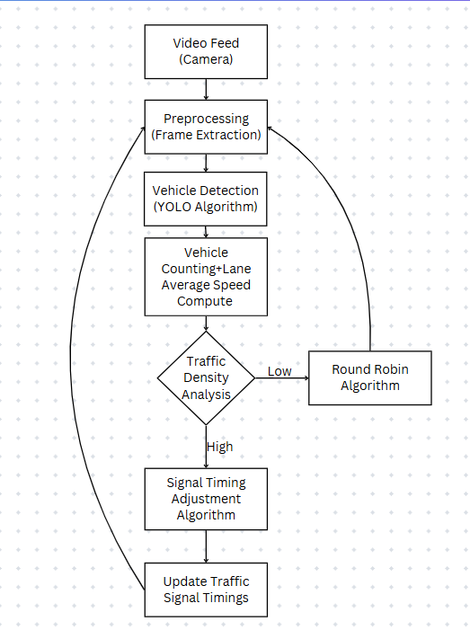
Flowchart

Slide 7
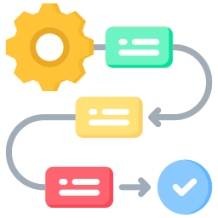
Methodology
Data Collection: Use pre-recorded traffic videos from four lanes to simulate real-world intersection scenarios.
Preprocessing: Extract and resize frames using OpenCV for model input preparation.
Vehicle Detection & Tracking: Apply YOLOv8 with DeepSORT to detect, classify, and uniquely track vehicles across frames.
Speed & Density Estimation: Calculate vehicle speed from centroid shifts and analyze lane-wise traffic density.
Signal Timing: Allocate green durations dynamically using cyclic fairness and average speed per lane.
Visualization & Output: Display real-time results via Streamlit and export vehicle data to CSV for reporting.

Slide 8
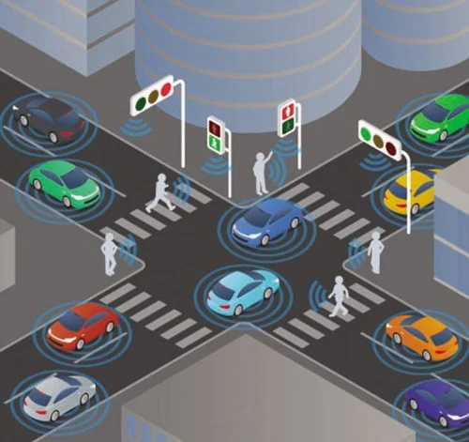
Expected Results
Key Outcomes:
Optimized traffic flow with reduced delays.
Fair signal allocation for all lanes, including low-density ones.
Scalable solution for urban intersections without additional infrastructure.
Impact:
Improved commuter experience.
Reduced emissions from idling vehicles.
Notes:
11

Slide 9
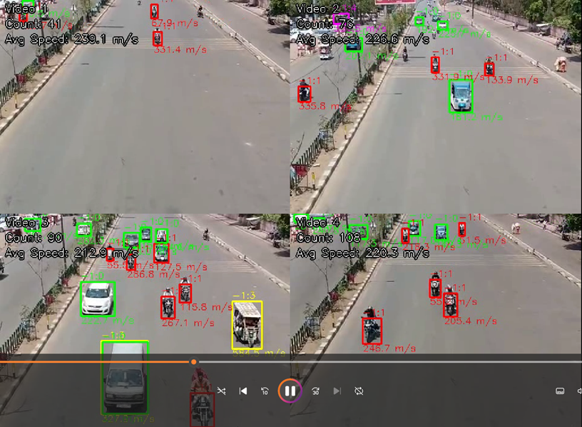
Sample Picture

Slide 10
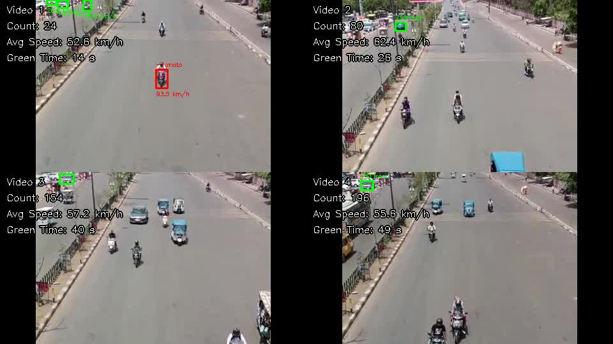
Working Video Demo

Slide 11
Conclusion
The proposed system uses machine learning to address urban traffic inefficiencies.
Dynamically adjusts signal timings based on real-time vehicle counts and average speed of vehicles per lane.
Ensures fairness for all lanes through cyclic rotation.
Provides a scalable and cost-effective solution for urban traffic management.
Potential for future extensions, including pedestrian detection and IoT integration.
Promotes sustainability through reduced emissions and optimized mobility.
Notes:
12

Slide 12
THANK YOU!

